Slide 1
How does the contact centre work?

Slide 2
In case you need to ask for a confirmation of study, apply for a merit scholarship, request enrolment to a higher year, submit a request to repeat a year or interrupt your studies or any kind of requests concerning the study department please use the Contact Centre.

Slide 3
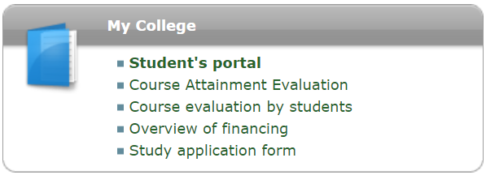
How to find the contact centre in UIS?

Slide 4
Find the contact centre icon

Slide 5
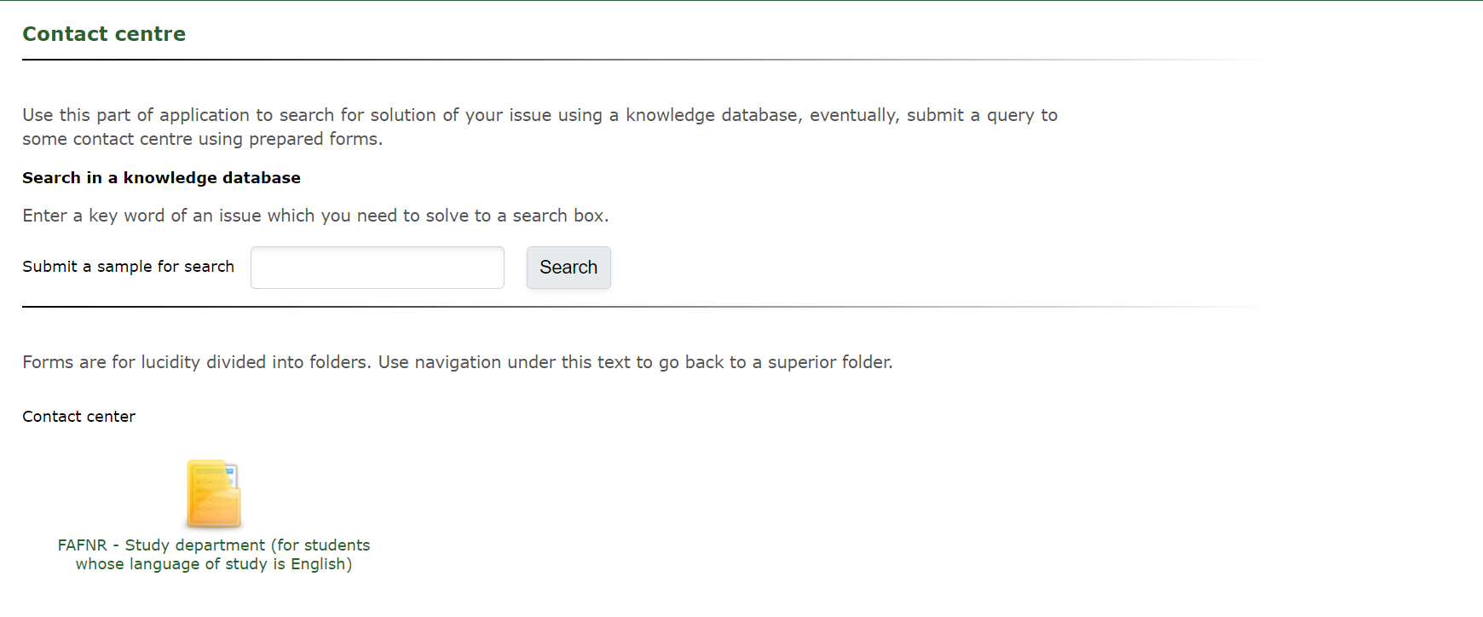

Slide 6
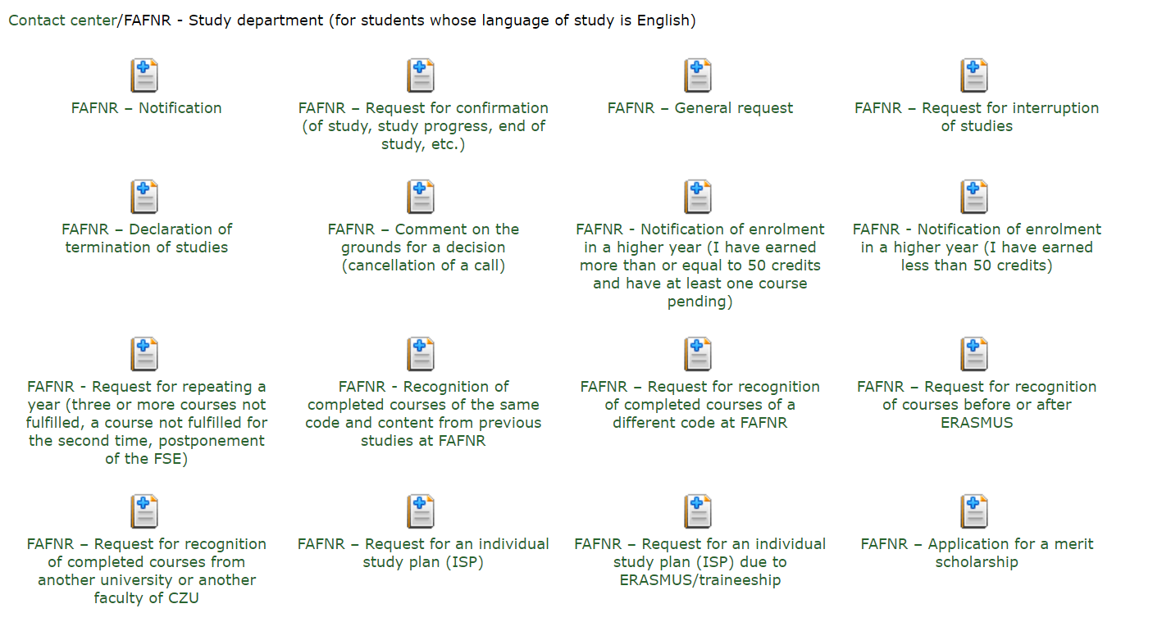
Choose a form that fits your needs

Slide 7
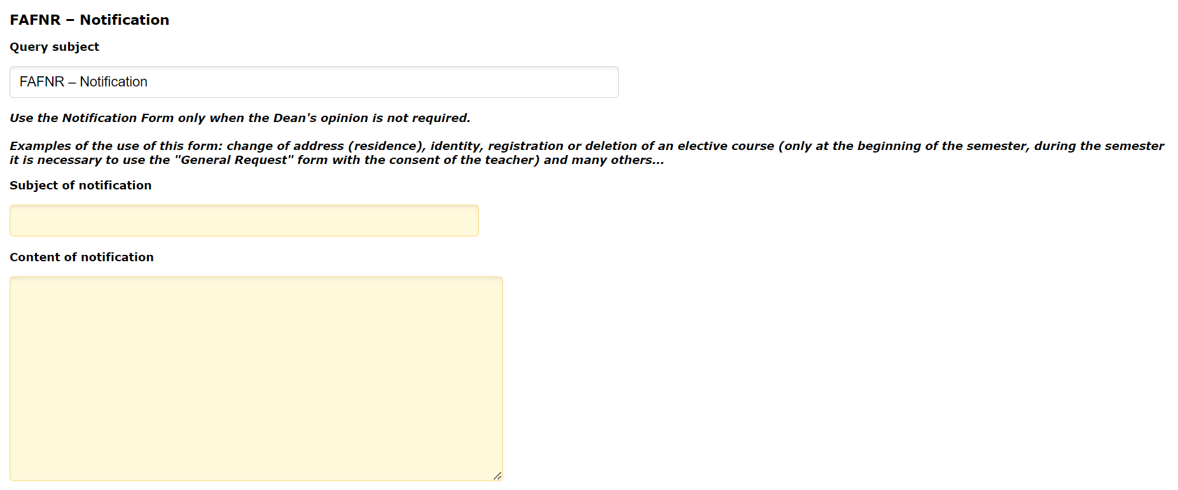
When you open any of the forms, you can find instructions and further details about the particular forms and what you need to fill in.

Slide 8
The study department will then check your request and try to solve it as soon as possible. You will be informed via email and UIS about the result.

Slide 9
Anything unclear? Please contact Mgr. Petra Hofmanová (hofmanovap@af.czu.cz)

